Slide 1

Event Triggered Hunger:
A Global Concern
Notes:
Event Triggered Hunger: A Global Concern

Slide 2
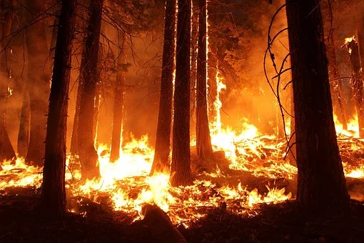

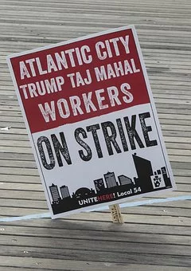


NATURAL
DISASTER
WAR
UNEXPECTED UNEMPLOYMENT
Notes:
There are various events that tend to cause a temporary food shortage or hunger problem. Some of them are natural disasters, war and unexpected unemployment.

Slide 3



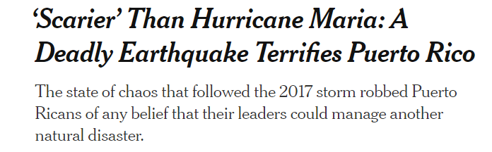
2019-2020 – Several earthquakes including 6.4 Magnitude
Massive Power Outages
Jose Andres’ World Central Kitchen served 2000 meals day of earthquake
WCK served 100,000 meals in one week
Notes:
Each year hurricanes leave hundreds of thousands of people uncertain where their next meal will come from. Jose Andres’ World Central Kitchen has kitchens and staff on the ground ready to jump into action when the need arises. The end of 2019 into the beginning of 2020 saw several earthquakes and aftershocks shake Puerto Rico including 6.4 and 6.0 magnitude quakes (Ayala, Mazzei, Robles, Garcia, 2020). Celebrity Chef Jose Andres started World Central Kitchen to respond to natural disasters. The day of the 6.4 quake, they served 2000 meals between 2 locations. One week later they had served one hundred thousand meals to over 90 locations. (World Central Kitchen, 2020) After hurricane Katrina I remember receiving a plea from our local food banks around Southern New Jersey. All the corporate donations were being diverted to the areas effected by the hurricane, there was not enough food to meet the needs of our local residents.

Slide 4
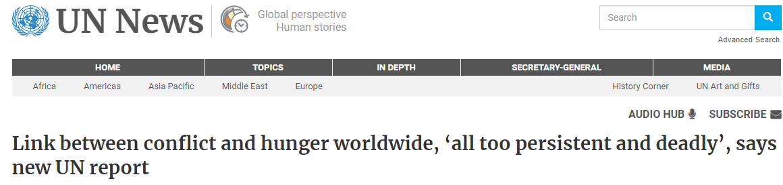
2018 saw around 56 million people in urgent need of food assistance across war torn areas of
Afghanistan
The Central African Republic
The Democratic Republic of the Congo
South Sudan
Yemen
Somalia
Syria
The Lake Chad Basin
Notes:
Hungry civilians are often the unseen victims of war. The UN reports that 2018 saw around 56 million people in urgent need of food assistance across 8 war torn regions. They were looking at Afghanistan, the Central African Republic, the Democratic Republic of the Congo, South Sudan, Yemen, Somalia, Syria and the Lake Chad Basin. (UN News, 2019) Having this information leads me to two thoughts on globalization. First, it reinforces the importance of ensuring that the United States continues to assist refugees from these areas. Second, it reminds me that the people who complain about refugees probably just don’t have an accurate global view on the issues faced by the peoples of these regions. There is a belief in some circles that refugees are just coming to take our stuff but the reality is that many find themselves making the choice between staying in the only homeland they have ever known and starving or finding their way to another country where they have a chance at survival.

Slide 5
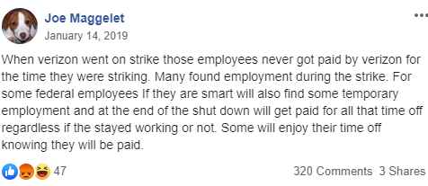

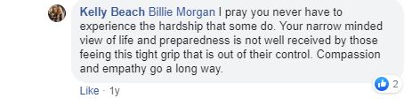
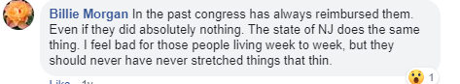
December 22, 2018 – January 25, 2019 The longest government shutdown in US history
Notes:
In the middle of the government shut down of 2018-2019 there was a lot of partisan talk on social media. What surprised me the most were some of the negative comments about workers that found themselves struggling to make ends meet. Of course there was also a lot of support. A thread on a local (to me) Facebook group started out with a comment about federal employees stating that they should find temporary work if they need it but some would just enjoy their paid time off. There was a lot of criticism of people who did not have savings to cover themselves during the shut down. There seemed to be an unbelievable number of people that felt that if people don’t have 6 months savings it’s their own fault, obviously unaware of the well known statistic that tells us that a large percentage of the population couldn’t afford a $400 emergency expence. On the flipside, there were plenty of people who stood up for the furloughed workers and even coordinated meals for them and offered temporary work.

Slide 6
Technology can help!
Communication
Fundraising
Matching those who can help with those in need
Awareness
Preparedness
Notes:
As a computer science major I think about all the ways technology can help. I plan on working in big data so that influences my perspective as well. Communication is huge. We need reliable communication to be able to spread news about what is happening and to coordinate any relief efforts. Technology can help if there is a fundraising need by getting the word out about the campaign and as a way to accept funds. Stored data can be used to target fundraising pleas to people who have been generous in the past. In some cases there may be a more focused approach to matching those who can help with those in need. Technology could show someone evacuating from a fire zone where the nearest shelter is set up. Awareness and preparedness tend to overlap like using technology to provide text notifications informing residents when an evacuation may be called for.

Slide 7
How does critically analyzing globalization add value to how you interact with people and understand social or global issues or events?
Prevents insensitivity
Find common ground
Understand other perspectives
Notes:
Critically analyzing globalization can help us avoid making insensitive comments. If someone is in an area devastated by natural disasters, it may not be wise to make comments about people buying out all the bread and milk before a storm. It can help you to find common ground with another person. Perhaps you went through something similar or know someone who did. You can use that understanding to guide your business relationship. If you are working with someone in an area in the middle of hurricane, tornado or fire season, they may need extra time or accommodations. Understanding someone else's needs provides the opportunity to offer accommodations before they need to ask for them.

Slide 8
Recommend strategies for using this kind of critical analysis for meeting your personal and professional goals. What might this look like in your everyday life? Consider how globalization can be used to address the day-to day responsibilities or questions faced by practitioners in your field or discipline.
Ask questions
Listen to answers
Don’t make assumptions
Educate yourself
Notes:
Because we live in such a global society there is a tendency to make assumptions about what is true in someone else's world or about what they know about ours. If I am working with an international company, or even one in a different region in the US, to build a database, it is important that I don’t make any assumptions about what fields they may want. If I needed to put options for a heating source and I did it based on my experience, I’d probably put electric or gas. Everyone I know uses one of those two heat sources. If the company works in a more rural area they may want to include propane and wood. There are probably other options out there that I wouldn’t think of. It is important to ask questions and listen carefully to the response so I can produce a great product for the client. There is also a certain amount of self education we can do when working with a global client. Depending on the project I could be helpful to be aware of the local terrain, are they in the mountains, near the coast, surrounded by forest. It could be helpful to know what products are produced in the region. There are many ways to research aspects of the company and area in preparation of a good business relationship.

Slide 9
Benefits and Challenges of addressing issues in globalization
Better understanding leads to better relationships
Same issue can seem different in various regions
Understanding without comparing
Notes:
Addressing issues in globalization leads to a better understanding which leads to better relationships. We can get into trouble when we think we understand, the same issue can actually seem very different in various regions. This is a time when asking questions and listening to answers can be helpful. We might say to someone “I understand that this is the way things are done in some regions of your country, is that true at your company?” Another part of addressing globalization is understanding without comparing. This is both a benefit and a challenge. There may be times that we don’t agree with someone else’s culture but we can still understand how those aspects of their culture mold their perspective. It can be extremely difficult to achieve that level of understanding but this type of empathy can be vital in building productive business relationships.

Slide 10
How does critically analyzing globalization add value to interactions?
“I think I was 13 before I ever saw a black person not on tv”
“I don’t even know what I don’t know!”
“a little knowledge is a dangerous thing”
Notes:
Critically analyzing globalization adds value to interactions because it provides a more thorough understanding of a topic or issue. A friend of mine is a teacher in rural Maine. She recently was talking about her personal efforts to become more global in her thinking about different cultures and experiences. At one point she says it’s “such a struggle for me since I don’t even know what I don’t know!” A couple of people in the conversation acknowledged that they were teenagers before they ever saw a non-white person not on tv. If we look back at the example of the federal workers during the government shut down, we see the responses from people who have never struggled. It is hard to understand something that you have never experienced but we must try. Even the most well intentioned people have bias simply due to lack of exposure, or sometimes even worse, limited exposure. It is said that a little knowledge is a dangerous thing. In terms of globalization I think this means that sometimes we take our limited knowledge or experience and try to apply it in broad strokes to an entire group or topic. In the global society we live in, it is important that we take the time to evaluate issues from a global perspective. Our world is incredibly vast yet oh so small in many ways. There was a time not too long ago that people living in small towns across America may not have felt the effects of globalization but with the help of the internet, that is no longer the case

Slide 11
Resources
Ayala, E & Mazzei, P & Robles, F & Garcia, S.E. (2020). ‘Scarier’ Than Hurricane Maria: A Deadly Earthquake Terrifies Puerto Rico. The New York Times. https://www.nytimes.com/2020/01/07/us/puerto-rico-earthquake.html
WCK activates in Puerto Rico in response to ongoing earthquakes. (2020). World Central Kitchen. https://wck.org/news/puertorico-earthquake
Link between conflict and hunger worldwide, ‘all too persistent and deadly’, says new UN report. (2019). UN News. https://news.un.org/en/story/2019/01/1031462
Pirani, F. (2019). This was the longest government shutdown in US history – A timeline of federal shutdowns. The Atlanta Journal-Constitution. https://www.ajc.com/news/national/when-was-the-last-government-shutdown-timeline- shutdowns/KlN1FLdhfBz9FznrrIBpTI/

